Slide 1

Capstone Project Phase A
Dopamine Booster Game
Advisor: Dr. Natali Levi
Roee Barzilai – 205791296
Yuval Hilai – 318609237
Notes:
Good morning, everyone my name is roee and my partner is Yuval, this is our project presentation for phase A called: dopamine booster game.

Slide 2
Table of Contents
01
04
02
05
03
06
Introduction
Engineering Process
Project Goals
Testing and Evaluation
Research Insights
Conclusions
Notes:
here we can see the list of topics we will discuss on in today's presentation

Slide 3
01
Introduction
Notes:
we start with an Introduction to explain some basic definitions regarding our topic and background.

Slide 4
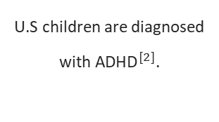
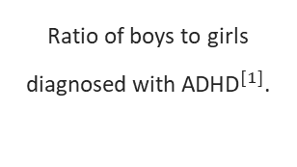
What is ADHD?
Attention-Deficit/Hyperactivity Disorder (ADHD) is a widespread neurodevelopmental disorder that significantly impairs daily functioning and performance in various settings.
3:1
11.4%
Ratio of boys to girls diagnosed with ${\text{ADHD}}^{[1]}$.
U.S children are diagnosed with ${\text{ADHD}}^{[2]}$.
1. Polanczyk G, de Lima MS, Horta BL, Biederman J, Rohde LA. The Worldwide Prevalence of ADHD: A Systematic Review and Metaregression Analysis. PLoS One. 2007
2. Danielson ML, Claussen AH, Bitsko RH, et al. ADHD Prevalence Among U.S. Children and Adolescents in 2022: Diagnosis, Severity, Co-Occurring Disorders, and Treatment. J Clin Child Adolesc Psychol. Published online May 22, 2024.
Notes:
First, we have ADHD I believe all of you have heard about it maybe even know it from close, so I would like to start with a small statistical fact here:
According to the CDC there are estimated 7 million Children are diagnosed with ADHD in the U.S, which is counted as eleven precent.
Now back to the definition: Attention-De-ficit Hyperactivity Disorder (or ADHD in short) is a widespread neuro develop mental disorder
that significantly impairs daily functioning and performance in various settings.

Slide 5

Symptoms and Challenges of ADHD
1
Inattention
2
Hyperactivity
Struggling to focus on tasks, easily distracted, forgetful, and Impulsivity.
Excessive fidgeting, restlessness, difficulty sitting still, and impulsiveness.
3
Academic Struggles
4
Social Challenges
Challenges with schoolwork, difficulty organizing assignments, and trouble completing tasks on time.
Difficulties with social interactions, managing emotions, and understanding social cues.
Notes:
Here we can see the some of the most major symptoms of ADHD: inattention, hyperactivity, Academic Struggles and Social Challenges. All of these and more are reflected in the day-to-day life of those struggling with ADHD.

Slide 6
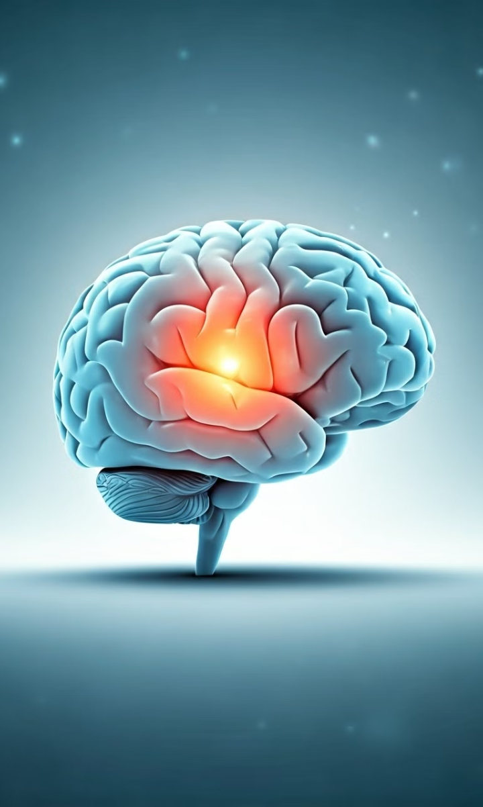
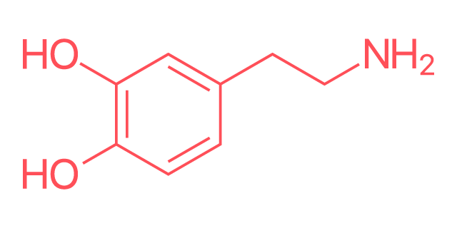
What is Dopamine?
Dopamine is a type of monoamine neurotransmitter. It’s made in your brain and acts as a chemical messenger, communicating messages between nerve cells in your brain and your brain and the rest of your body.
Notes:
Second, we have Dopamine which is a type of monoamine neurotransmitter. It’s made in our brain and acts as a chemical messenger,
communicating messages between nerve cells in the brain and the brain and the rest of the body.
Dopamine plays a role in many body functions, and we will talk about it more later in the presentation.
מונואמינים הם מוליכים עצביים במערכת העצבים הבנויים מקבוצת אמין
Monoamines are neurotransmitters in the nervous system from the amine group

Slide 7
Problem
Many ADHD patients have difficulty accessing or persevering to the “traditional treatments”. They are all treated by the same ideology which is mainly the same way for everyone and include use of medications. We identify this as a problem, and we will look for a solution for it with an alternative approach.
Notes:
Here we can see our definition of the problem our project addresses: Many ADHD patients have difficulty accessing or persevering to the “traditional treatments”.
They are all treated by the same ideology which is mainly the same way for everyone and include use of medications. We identify this as a problem, and we will look for a solution for it with an alternative approach.
An approach that does not make it expensive and so easy to distribute medicines.
now let's go back to talk about what is this term “Traditional Treatment” mention because it's crucial to understanding our approach to the problem.

Slide 8
Traditional Treatments for ADHD
Medication
Therapy
Educational Support
Stimulants (e.g., methylphenidate) and non-stimulants (e.g., atomoxetine) can improve focus, attention, and hyperactivity.
Cognitive behavioral therapy (CBT) teaches coping mechanisms and strategies for managing ADHD symptoms.
Modifications to the learning environment, such as individualized education plans (IEPs) and accommodations, can help children succeed in school.
$${\text{Traditional} \text{Treatments} \text{were} \text{established} \text{in} \text{the} \text{1990}\text{s} \text{and} \text{continue} \text{into} \text{today}\text{′}\text{s} \text{time} }^{[1]}$$
1. Barbaresi, W. J., et al. (2002). Modifiers of long-term school outcomes for children with ADHD: Does treatment with stimulant medication make a difference? Pediatrics, 110(1), 71-78.
Notes:
The Traditional Treatments is a global standard for ADHD treatment that can be summed up by three key steps:
Recognize ADHD as a chronic condition and involve the family and school staff, with specific outcomes in mind.
Tailor and assess treatment: Recommend stimulant medications and/or behavioral therapy, based on the child’s response.
Ensure regular follow-up: Continuously monitor outcomes and side effects, with feedback from parents, teachers, and the child.
And it's important to note that this treatment standard hasn't changed at all for many years even with the constant advance of technology.

Slide 9

Limitations of Traditional Treatments
Side Effects
Limited Efficacy
Medications can cause side effects such as appetite suppression, insomnia, and headaches.
Not all individuals respond to medication or therapy, and some symptoms may persist.
Cost and Accessibility
Medication and therapy can be expensive and access to qualified professionals can be limited.
Notes:
Here we can see in short that the Traditional Treatments has a few limitations the three most significant of them we recognize as part of the problem are:
Medications Side effects, Cost and Accessibility and Limited long-term Efficacy.

Slide 10
02
Project Goals
Notes:
In this section we will present our solution idea.

Slide 11
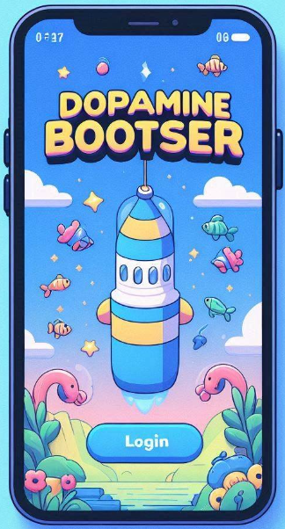
Solution
We propose a mobile game that leverages neuroscientific research on dopamine to help users with ADHD improve focus and attention through gameplay.
Notes:
With Today’s advance technology we can do a lot better.
Our team with the help of our project advisor came up with solution idea of propose a development of a new mobile game
that leverages neuroscientific research on dopamine to help users with ADHD improve focus and attention through gameplay.
our vision is to gain significant impact on the traditional treatment and to gain recognize in the medical field.

Slide 12
03
Research Insights
Notes:
In the next section we will talk shortly about our project research process

Slide 13
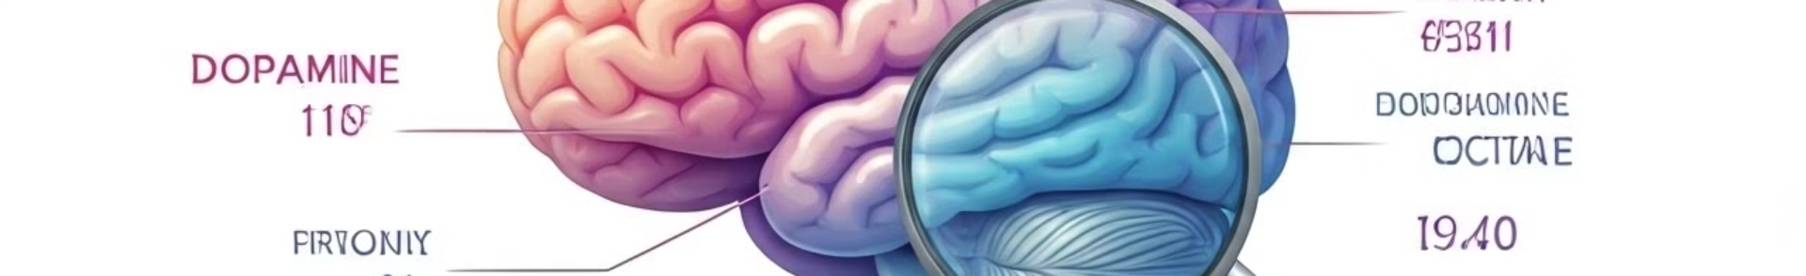
The Role of Dopamine in ADHD
Neurotransmitter Imbalance
Difficulty with Reward Processing
Individuals with ADHD often have lower levels of dopamine, a neurotransmitter that plays a key role in attention, motivation, and reward.
Lower dopamine levels can lead to difficulties experiencing pleasure and motivation, making it challenging to stay engaged in tasks.
1
2
3
Challenges with Executive Function
Reduced dopamine levels can impair executive function, impacting planning, organization, and self-regulation.
Notes:
We started our research with the role of dopamine in ADHD and how It plays a crucial role in regulating mood, attention, motivation, and reward.
We found that low levels of dopamine are linked to challenges in focus and impulse control and more, but most seen in conditions like ADHD.

Slide 14

Gamification
Gamification - the application of game design elements in non-game contexts, has rapidly gained traction in various fields, including education, business, and healthcare.
Notes:
We start with the definition of Gamification - is the application of game design elements in non-game contexts,
has rapidly gained traction in various fields, including education, business, and healthcare.
Gamification aims to engage with consumers to inspire collaboration, sharing and interaction through game mechanics and game that lead to the accomplishments of goals and objectives.
Since games are shown to increase dopamine production through rewards and accomplishments we chose to combine this approach with our solution.
From here Yuval will continue.

Slide 15


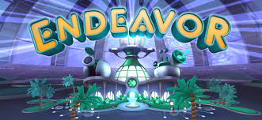
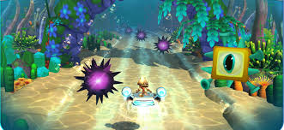
Current Solution
What is it? EndeavorRx is a video game for ADHD Treatment first to be approved by the FDA to help kids (ages 8-17) with ADHD improve their focus and attention.
How it works?
The game has different tasks, like moving through obstacles, collecting rewards, and quickly switching between goals. These tasks challenge the brain to focus, react quickly, and stay on task.
Disadvantages:
Only works on iOS devices (iPhone, iPad).
It’s expensive because you need a
doctor’s approval and pay to use it.
It doesn’t limit screen time,
which could lead to decreased physical
activity and disrupted sleep.

Slide 16
04
Engineering Process

Slide 17
Technical Implementation
Introduction: We are using both frontend and backend technologies to build our game.
Frontend (Client-Side):
Unity 3D: Builds the game’s interactive features (Unity C#).
Flutter: Designs the user interface and experience.
Backend (Server-Side):
Firebase: Manage user login, perform real-time updates, and for data analytics (storage and updates).
Cross-Platform Compatibility:
Support for iOS and Android devices using Unity’s cross-platform deployment tools and plugins.

Slide 18
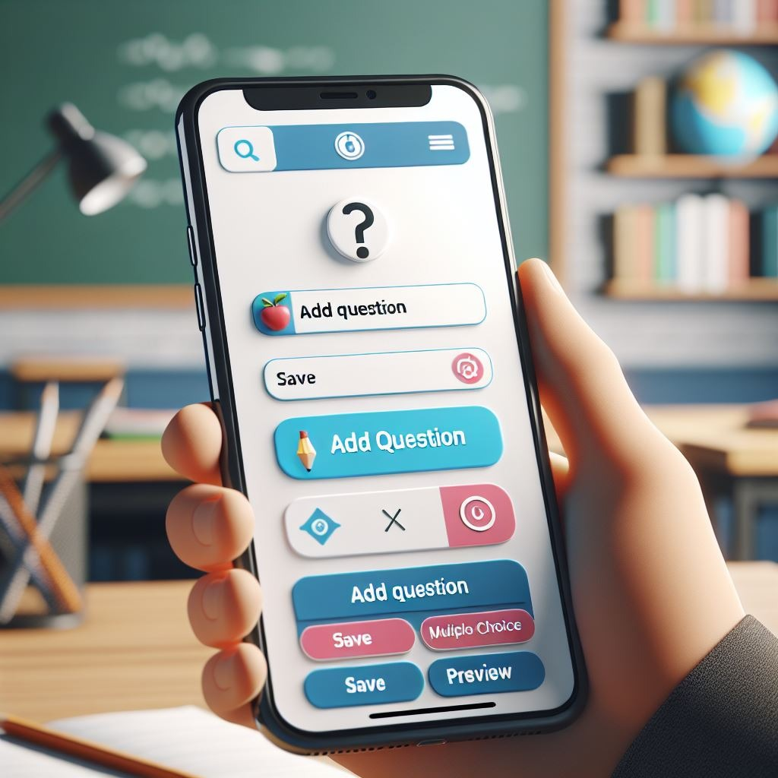
Functional Requirements
The system provides a separate interface for teachers or parents to monitor the progress of the children using the app.
The system allows teachers or parents to provide feedback on the game's impact on the users.
The system allows to add questions and answers by the teacher interface.
The system allows student to answer and submit answers for teacher assignment.
The system allows automatic feedback of the grade of student assignments for the teacher.
Notes:
Here are a few of the functional requirements regarding our game.

Slide 19
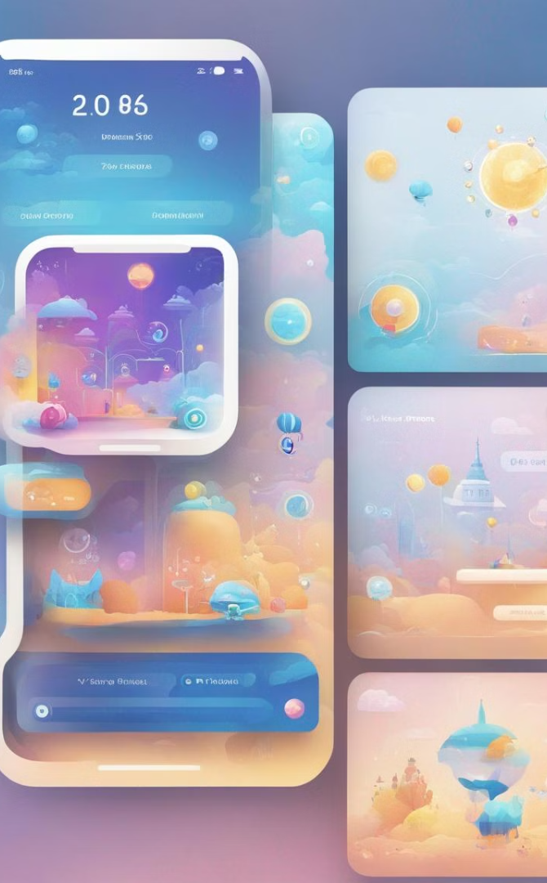






Game Design Elements
Dopamine-Stimulating
Gameplay
Cognitive Stimulation
Our game will engage players with challenges like completing levels and provide immediate rewards such as points, badges, and in-game currency.
Our game will set short-term goals like finishing tasks within a time limit. Create long-term goals such as reaching higher levels.
Reward System
Physical Activities
Our game will give instant rewards and updates. Parents will get notifications about their child’s progress and achievements.
Our game will Incorporate physical actions, like jumping or moving around, to keep players active and engaged.
Notes:
Heb and English support add flags

Slide 20
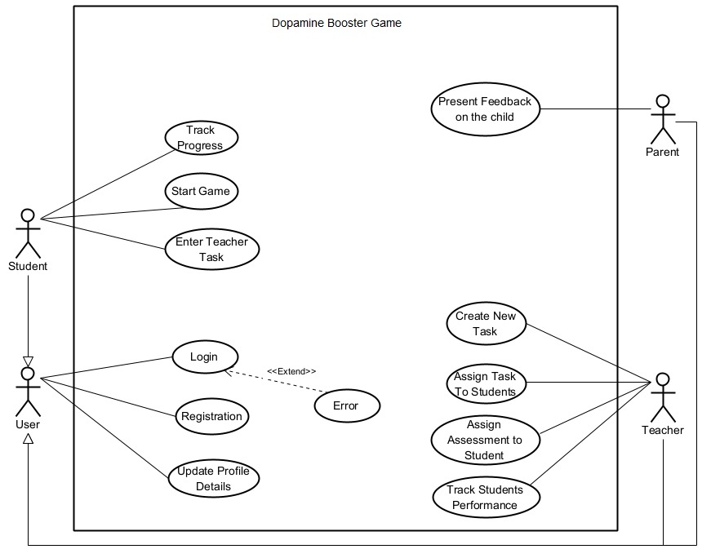
Product Diagrams
This diagram outlines the roles and actions of different users within the Dopamine Booster Game, showing how students, teachers, parents, and users interact with the system.
Notes:
The following Use Case diagram shows the Student, Parent and Teacher Interaction with the system.

Slide 21
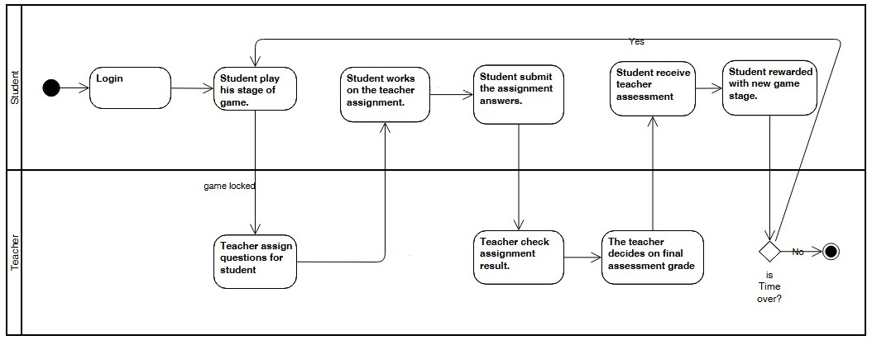
Product Diagrams
This Activity diagram outlines the interaction process between students and teachers within the game while in lesson, highlighting the balance between educational tasks and dopamine induce gameplay rewards.

Slide 22
05
Testing and Evaluation

Slide 23
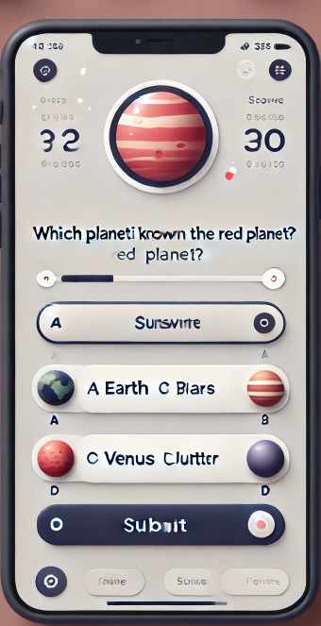
Testing
We are in the process of obtaining approval from the Chief Scientist , which will allow us to conduct the test.
Once approved, we will test the game in a classroom setting with children aged 8-15. The students will play the game during lessons, and we will gather feedback from both students and teachers.

Slide 24
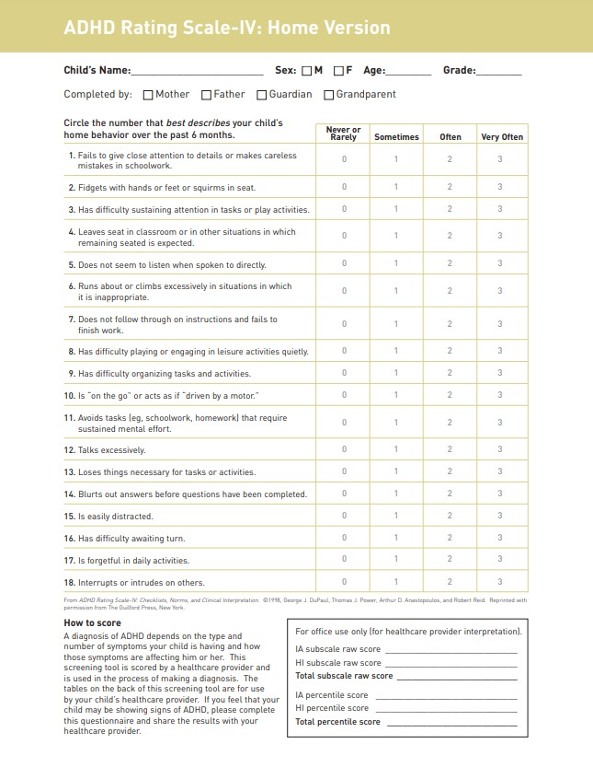
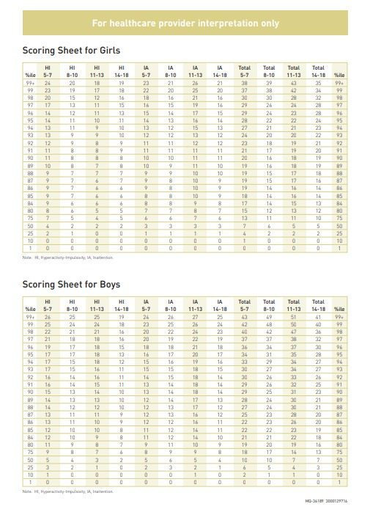
Evaluation
To measure the impact on attention and concentration, the teacher will create and submit quiz questions based on the lesson's content. Students will solve the task within the app, and we’ll compare their results to lessons conducted without the game.
Additionally, teachers will fill out surveys about the students behavior and focus, allowing us to track improvements over time.

Slide 25
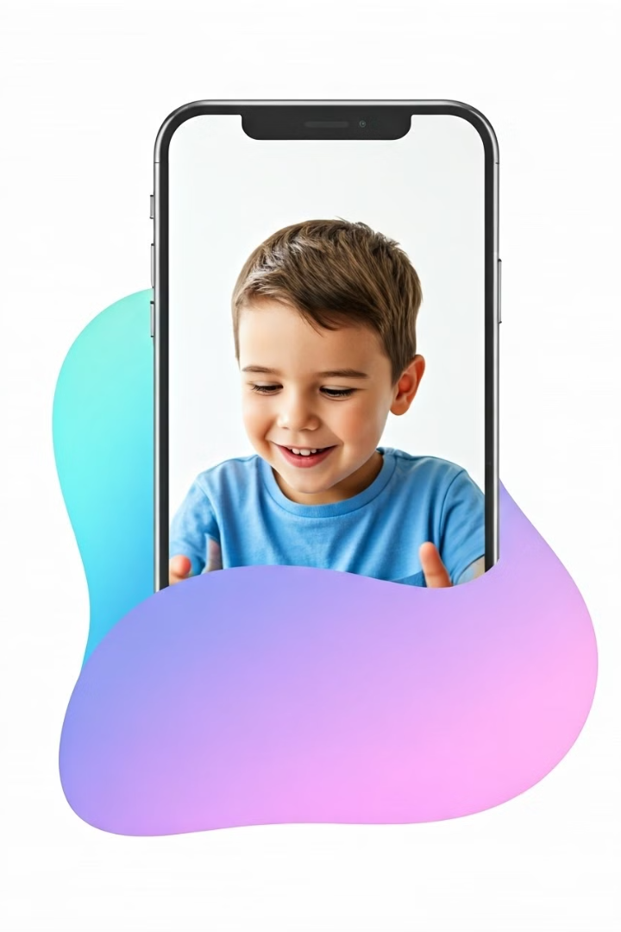

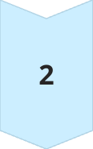
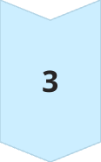
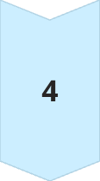
Expected Outcomes
We expect the game to improve attention span during
and after gameplay.
We expect users to report higher enjoyment and give
positive feedback.
We expect teachers to observe better focus in classrooms.
We expect students to perform better on tasks after using
the game.
In the long term, to influence a change on the traditional
treatment with the help of the integration of
gamification technology.

Slide 26
06
Conclusions

Slide 27

Conclusions
The Dopamine Booster Game presents a new, accessible, and effective way to manage ADHD symptoms through a gamified approach.
By incorporating game elements that increase dopamine levels, and engaging game mechanics, we can offer a solution that has the potential to positively impact millions of ADHD patients.
Our project is not just about creating a game, it’s about leveraging technology to solve a real-world problem and improve lives.

Slide 28
Thank You
Question?

